Slide 1

Predicting Total Uber Cab Fare Using Mongo-dB and Spark
NAME: Abhishek Lal
Roll No.: C23039

Slide 2
CONTENTS
Objective
EDA
Analysis.
Correlation Analysis
Data Preparation
Pipeline Creation And Data Normalization
Model Building
Output

Slide 3
OBJECTIVE
In this project focused on predicting total cab fare, our aim was to build a model using the Spark distributed data processing framework. The model would estimate the charges individuals would incur based on factors such as total distance travelled, surge applied, trip duration, tip etc. To efficiently manage and analyze the medical insurance data, we integrated MongoDB with Spark.

Slide 4
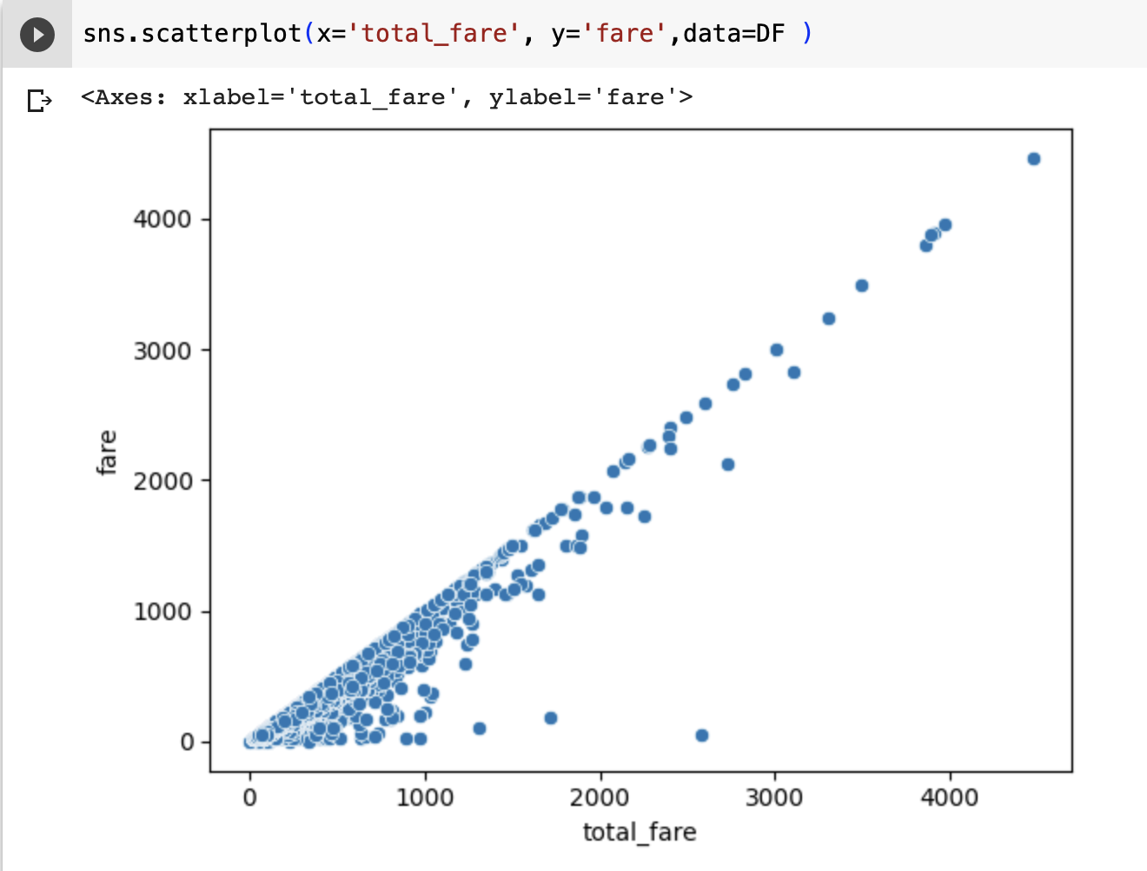
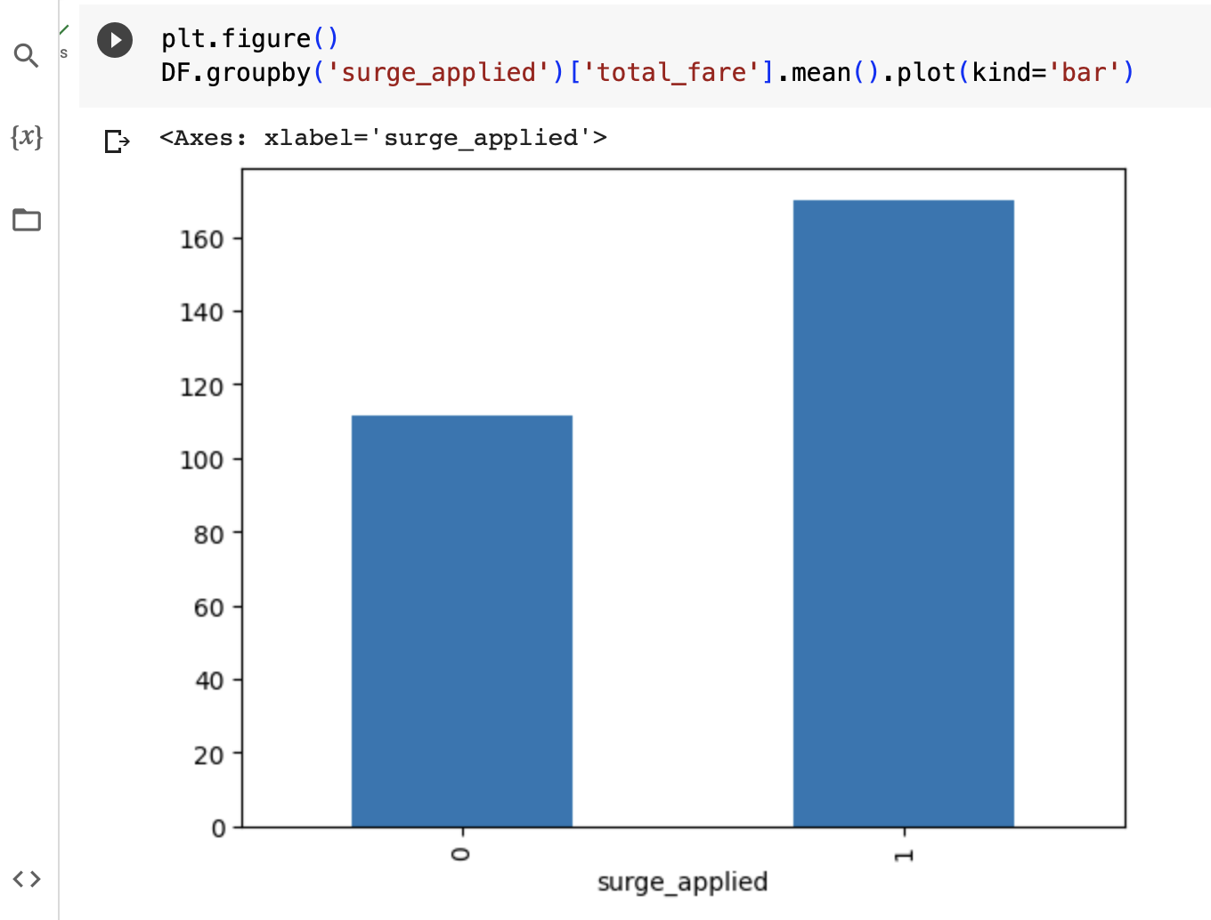
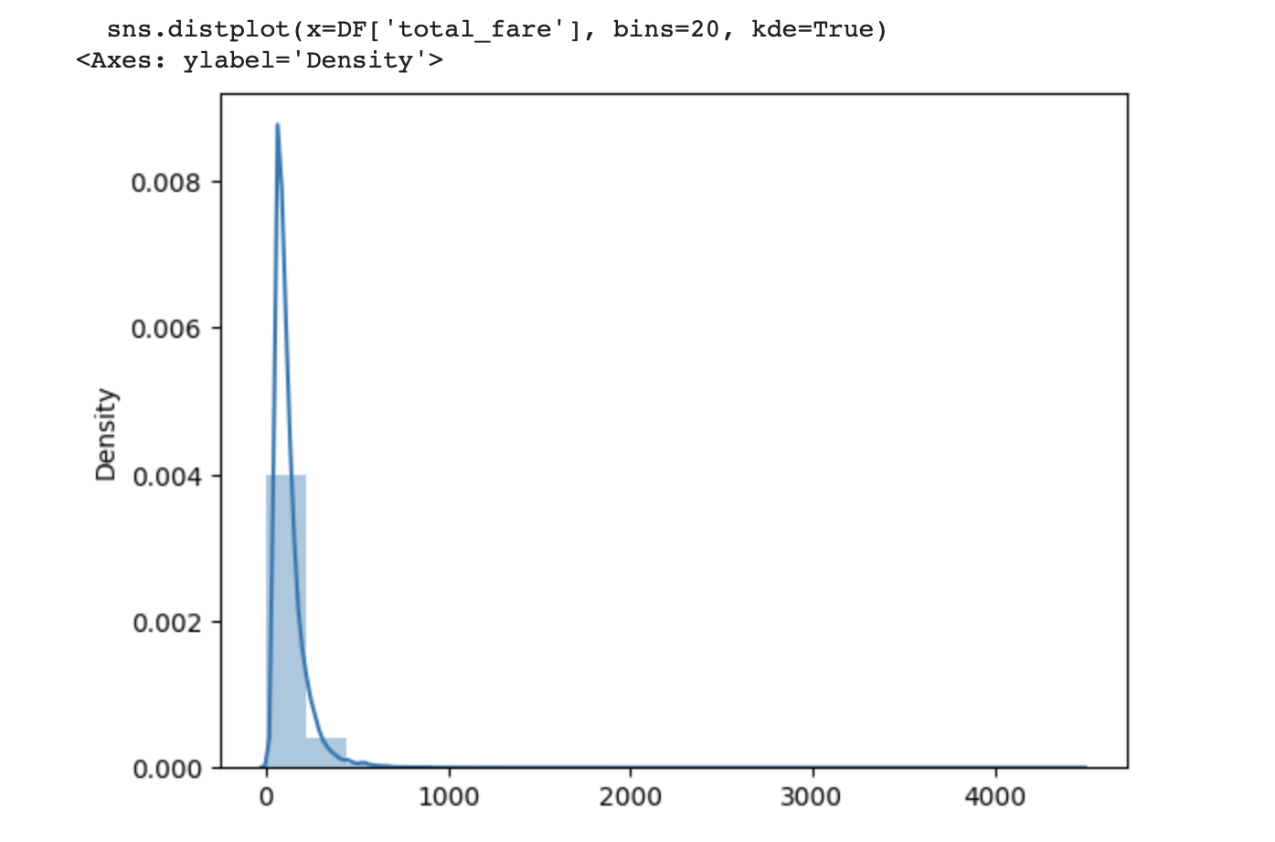
EDA

Slide 5
ANALYSIS:
Based on the analysis, I find that the Uber Cab Fare is. skewed
The average cab fare is higher when the surge applied than the average cab fare when surge is not applied
Fare is linearly dependent on the Total fare

Slide 6
DATA PREPARATION
Removed the fare column as the fare is completely linearly dependent on the total fare. So, the column which explains the target variable in maximum is deleted
Surge applied is already in 0s and 1s. So, the variable is already one hot encoded
We have applied the Standard scaler to scale the data, so that the data becomes normal

Slide 7
NORMAlIZING THE DATA
A Standard Scaler is employed to scale the features within a consistent range. The Standard Scaler ensures that each value is scaled to a range between 0 and 1, enabling fair comparisons and reducing the impact of varying feature magnitudes.

Slide 8
MODEL BUILDING
The train-test split involves dividing the scaleddf dataset into two separate datasets: the training dataset and the test dataset.
This split is achieved using the randomSplit() method, which takes two parameters: weights and seed.
The weights parameter determines the relative sizes of the resulting datasets, while the seed parameter is optional and used for reproducibility purposes.
In this case, the training dataset is allocated 70% of the data, while the test dataset receives 30% of the data.

Slide 9
OUTPUT
Model is applied on the data.
Linear regression is able to explain almost 30% of the target variable with RMSE value 83.67
Decision Tree Regressor is able to explain 72% of the target variable with RMSE value 51.48
So, we will go forward with Decision Tree Regressor.

Slide 10
THANK YOU

